Slide 1

Atomic Habits — Book Review
By James Clear — Presented by Muhammad Usman (Roll No: BSE-24F-642)
Subject: Expository Writing

Slide 2
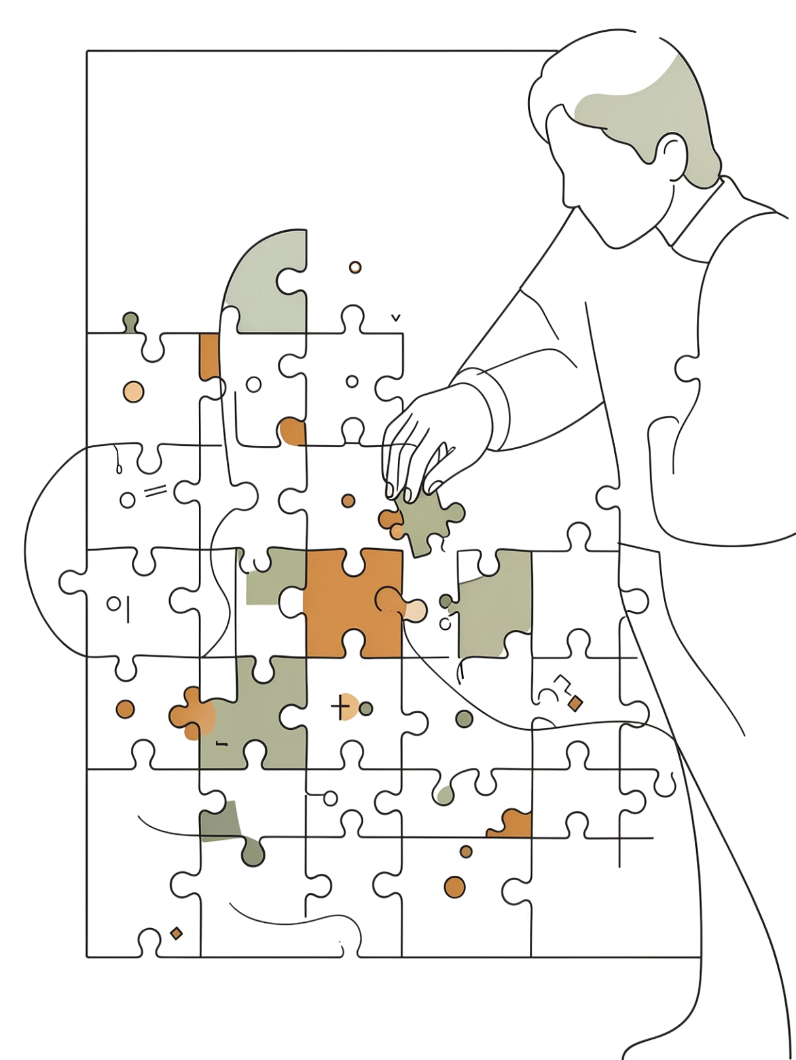

What is Atomic Habits?
Published in 2018, James Clear’s Atomic Habits explains how tiny, consistent changes compound into significant personal transformation. The term "atomic" highlights the idea of very small units with powerful effects. Clear argues that systems and daily routines — not dramatic once-off efforts — create lasting results.
Core message: small habits compound; design your environment and systems to make good habits inevitable.

Slide 3
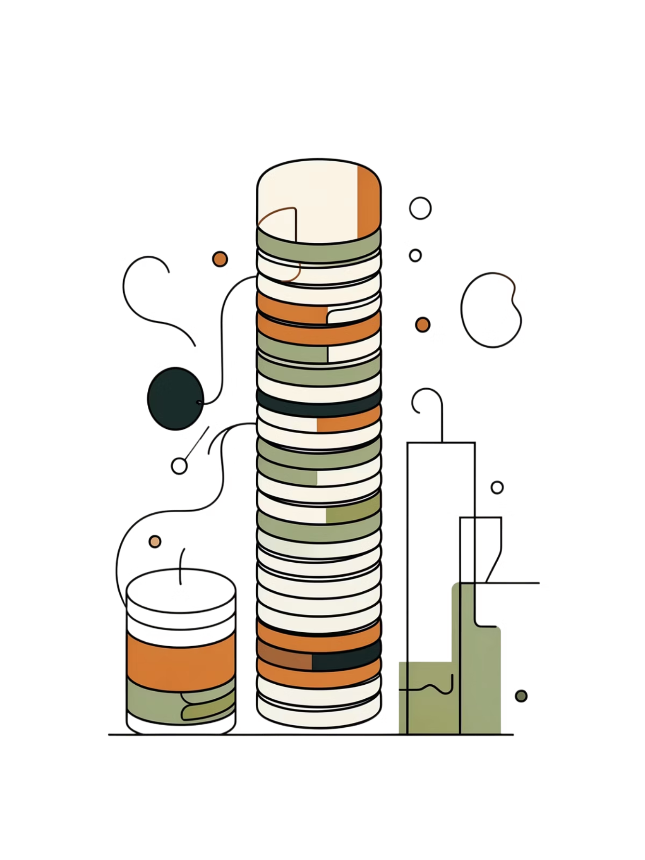
The 1% Rule — Why Small Habits Matter
Improving by just 1% each day produces exponential gains over time. Conversely, tiny declines compound negatively. The key challenge isn’t understanding compounding — it’s sticking with the process long enough for effects to appear.
Compound Growth
Small gains accumulate into major outcomes across months and years.
Patience Required
Progress is often invisible early on — consistency beats intensity.

Slide 4

INSTANT VS DELAYED REWARDS
Why are bad habits so easy, and good habits so hard? Behaviour change is a battle between what feels good now vs. what's good later.
Bad Habits
Provide Immediate Joy but result in Delayed Pain.
Example: Playing games feels great now, but causes lost time and stress later.
Good Habits
Require Immediate Pain (Effort) but result in Delayed Joy.
Example: Studying is tough now, but brings career success and knowledge later.

Slide 5
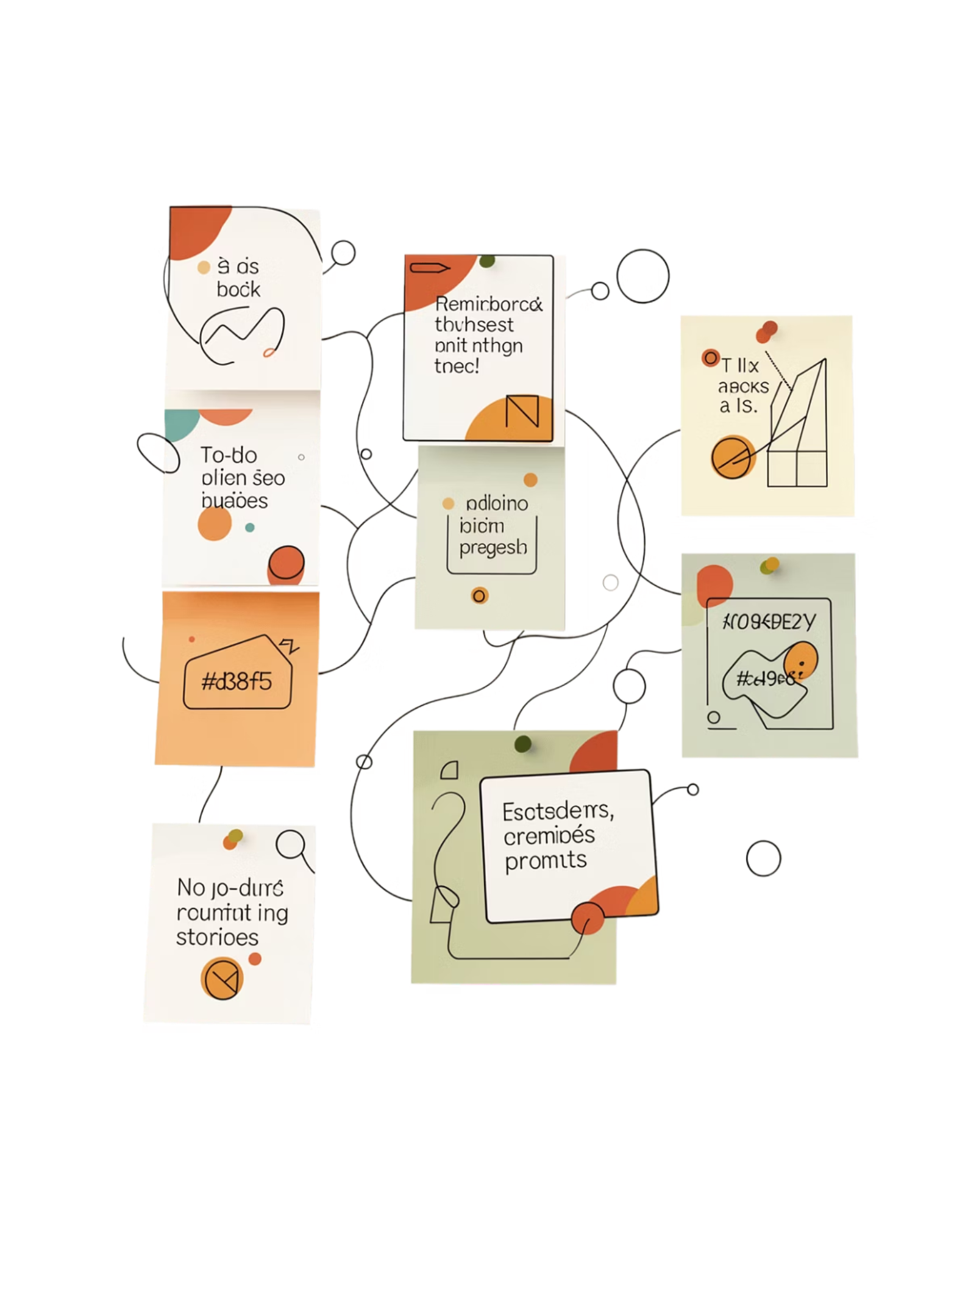

The 4 Laws of Behavior Change
Use these four practical rules to build habits that stick — and reverse them to break bad habits.
1. Make it Obvious
Design visible cues and set specific implementation intentions (when/where).
2. Make it Attractive
Bundle habits with enjoyable activities to increase motivation.
3. Make it Easy
Reduce friction by shrinking tasks; aim for the two-minute start rule.
4. Make it Satisfying
Use immediate rewards and tracking to reinforce repetition.

Slide 6


Practical Tools & Strategies
Implementation intentions: "When X happens, I will do Y."
Habit stacking: attach new habits to existing routines.
Environment design: make cues for good habits visible and remove triggers for bad ones.
Two-minute rule: start any habit by doing it for two minutes to beat resistance.
Small structural changes (where you keep your phone, how you arrange study materials) dramatically affect behavior.

Slide 7
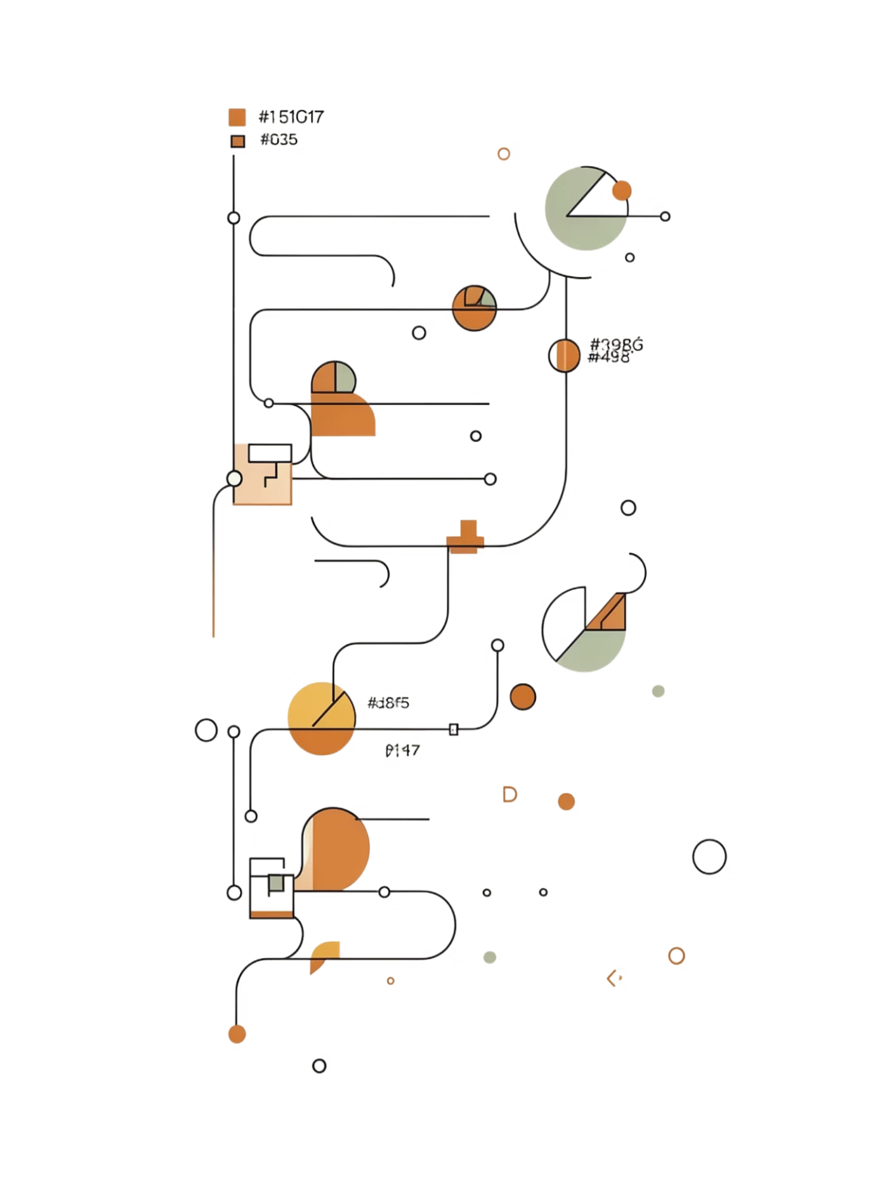
Common Pitfalls & How to Avoid Them
Looking for quick fixes
Expect slow, compounding improvement rather than instant results.
Skipping systems
Focusing only on goals leaves you without repeatable routines.
Inconsistent environment
Design context to make good choices the default path of least resistance.

Slide 8
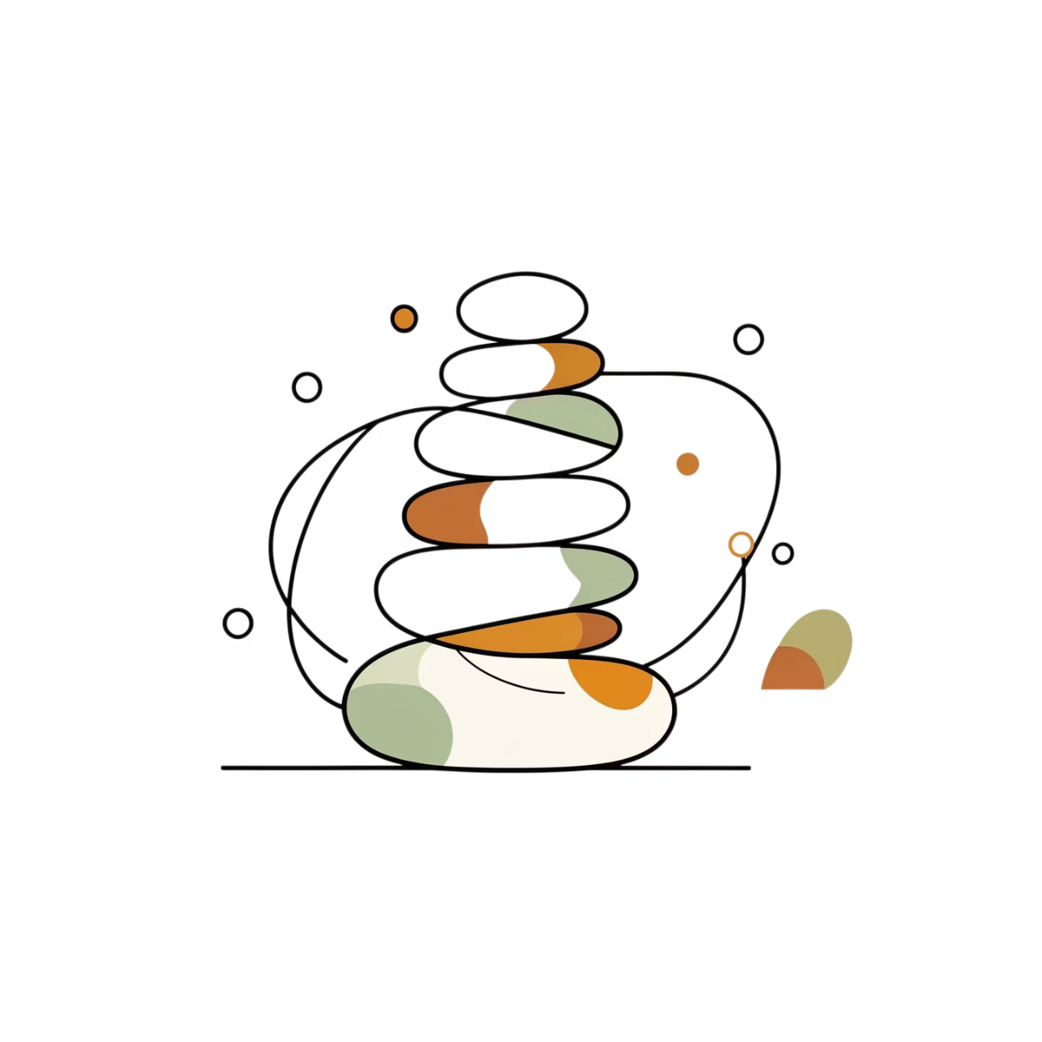
Key Takeaways
Small daily actions compound into major results over time.
Follow the 4 laws to build or break habits: Obvious, Attractive, Easy, Satisfying.
Systems and identity matter more than one-off goals.
Environment design and tiny starts make habits reliable.
Adopt a mindset of continuous improvement — aim for 1% better every day.

Slide 9


Final Reflection & How to Apply It
"You do not rise to the level of your goals. You fall to the level of your systems." — James Clear
Start Small
Pick one tiny habit you can repeat for two minutes.
Design Your Environment
Make the cue obvious and the next step easy.
Track & Celebrate
Use simple tracking and small rewards to make the habit satisfying.
Action step for students: Pick one tiny habit to start this week and track it for 30 days.

Slide 10
THANK YOU

