Slide 1


Slide 2
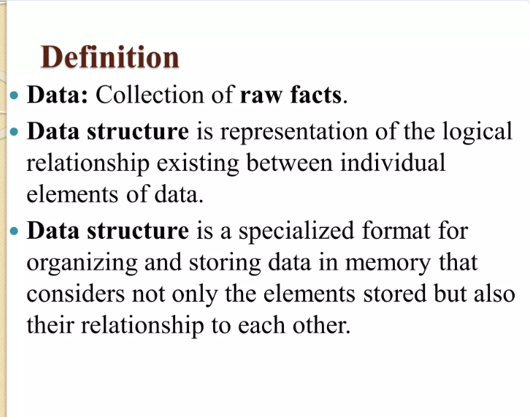

Slide 3
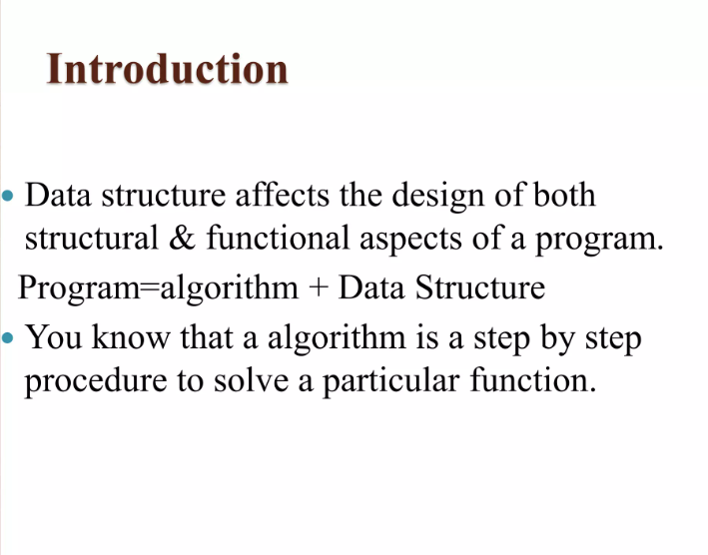

Slide 4
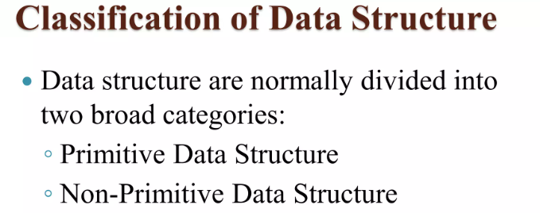
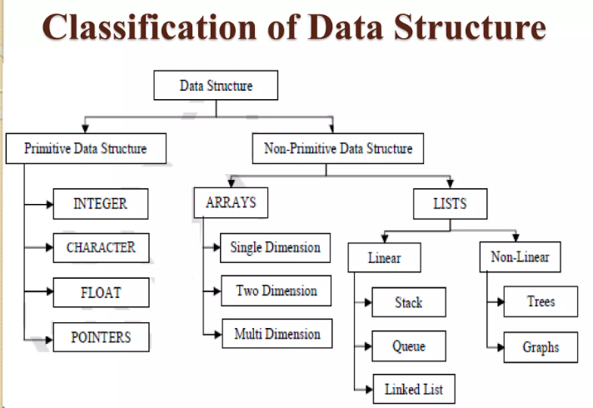

Slide 5
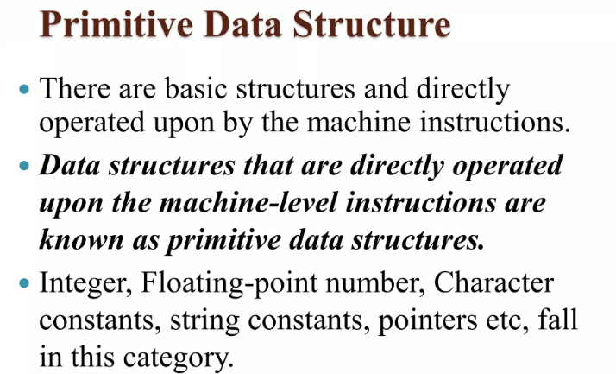
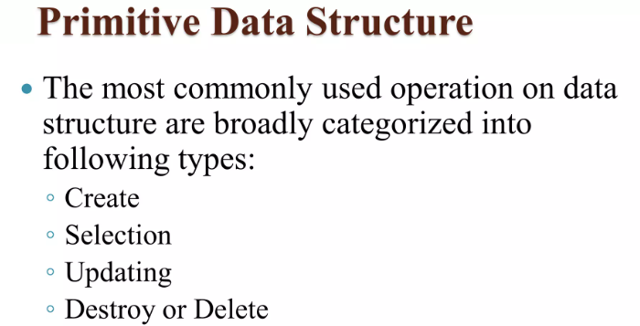

Slide 6
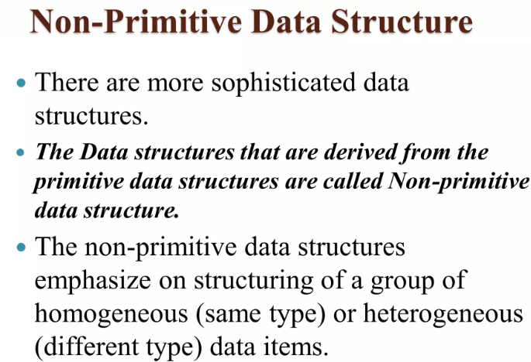

Slide 7
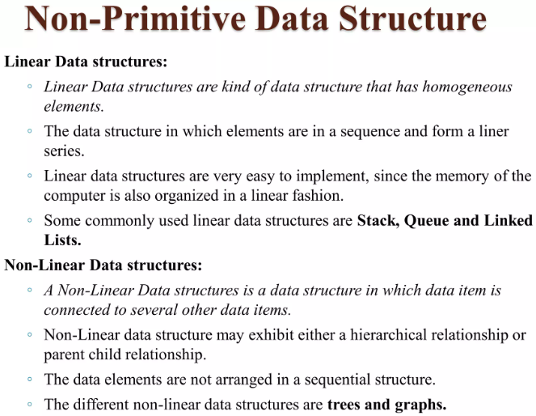

Slide 8
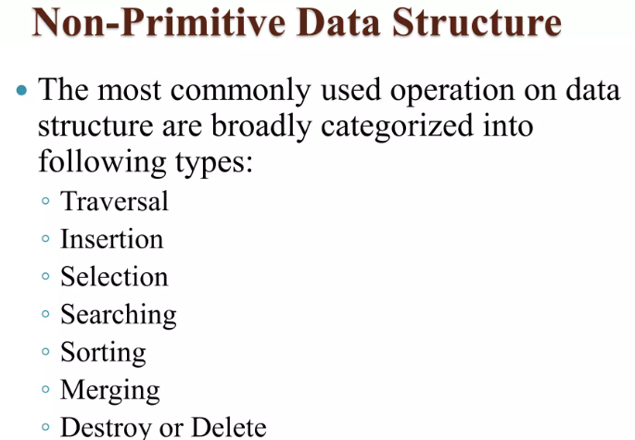
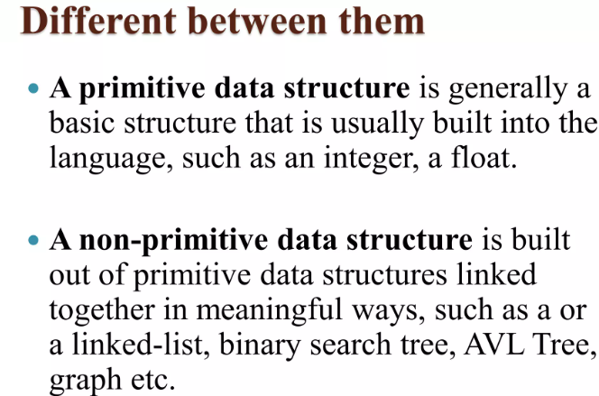

Slide 9
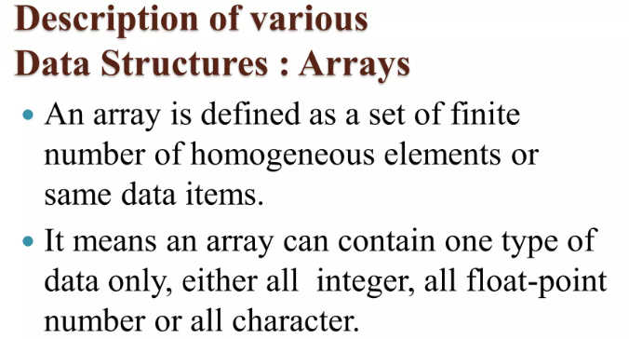
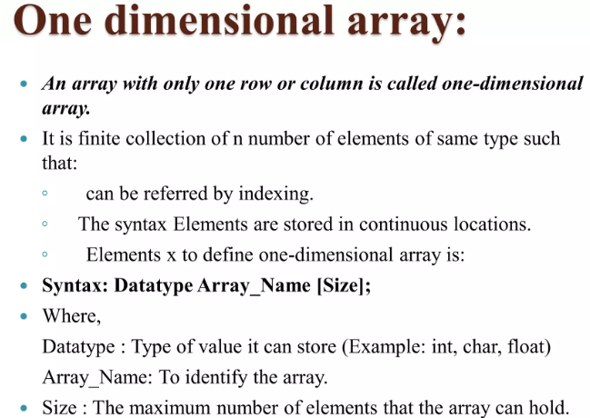

Slide 10
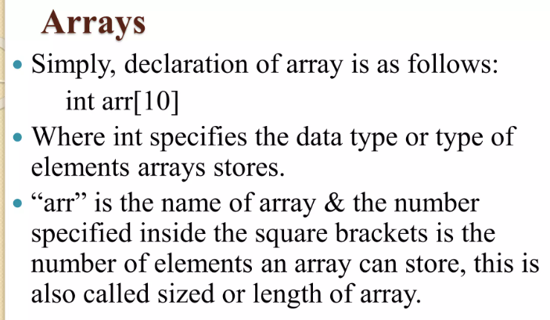

Slide 11
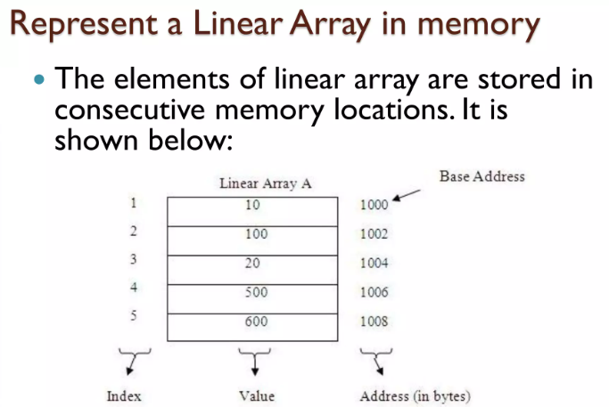

Slide 12
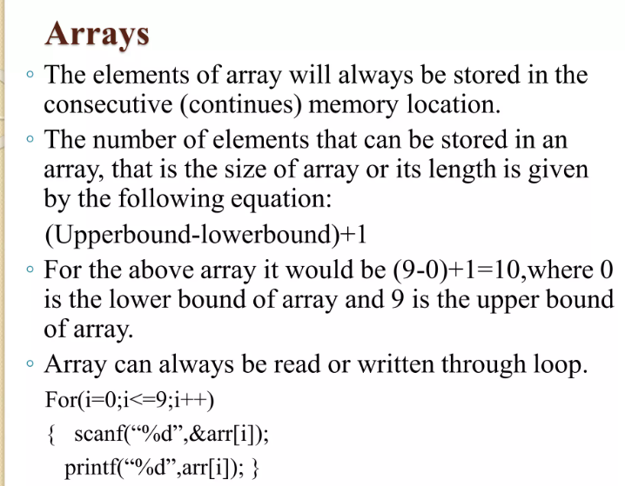

Slide 13
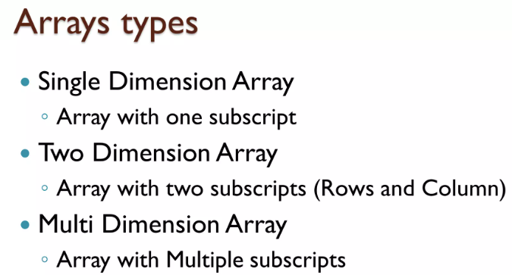
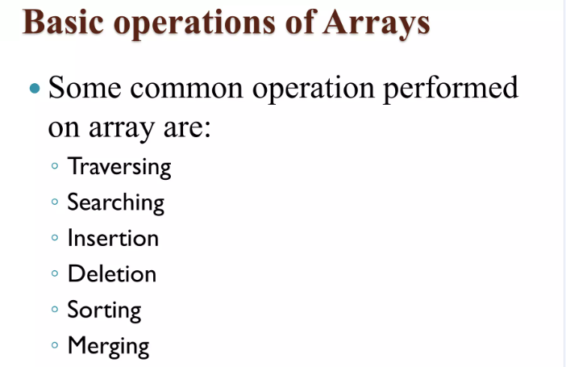

Slide 14
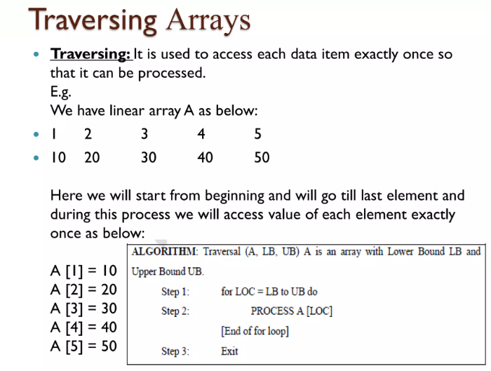

Slide 15
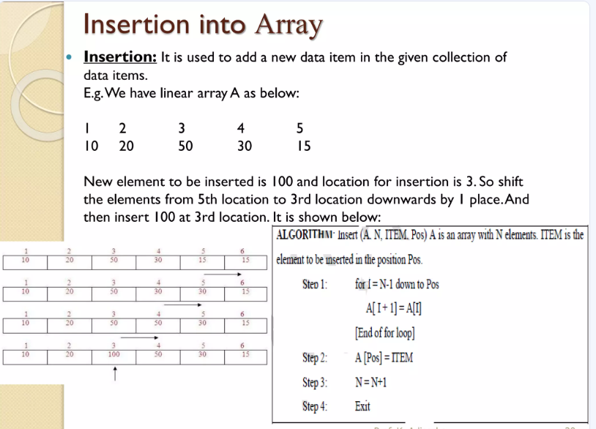

Slide 16
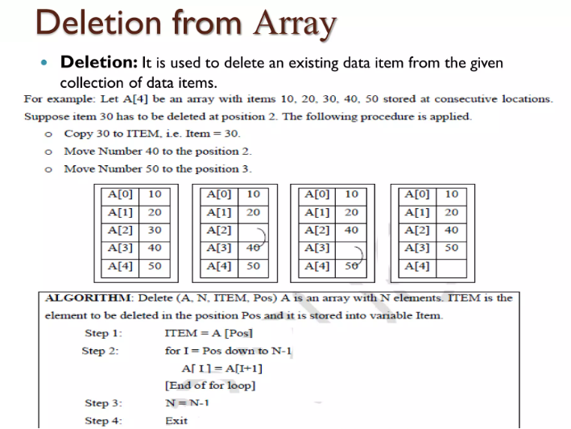

Slide 17
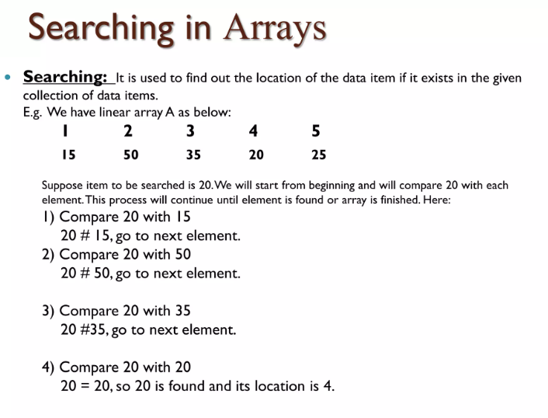

Slide 19
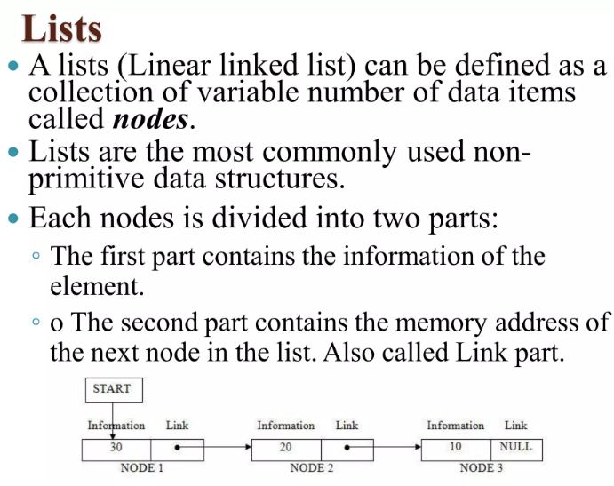

Slide 20
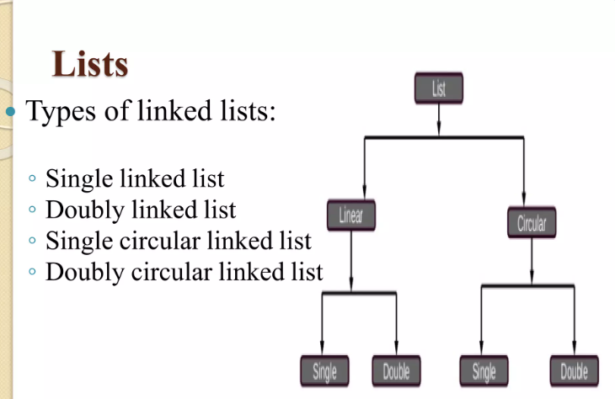

Slide 21
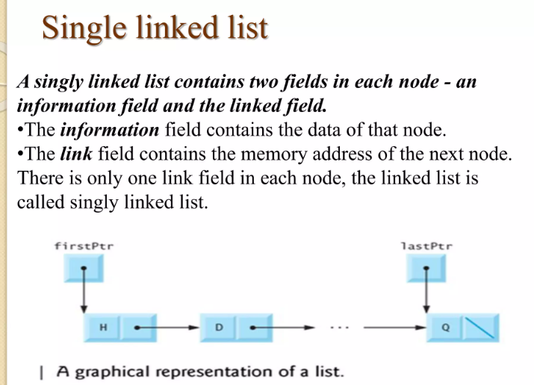

Slide 22
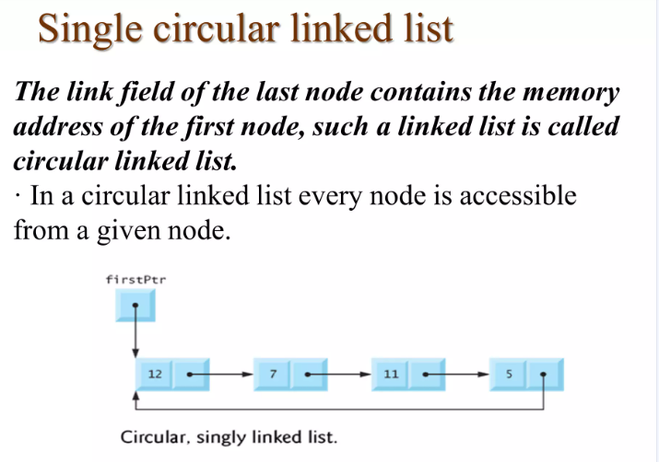

Slide 23
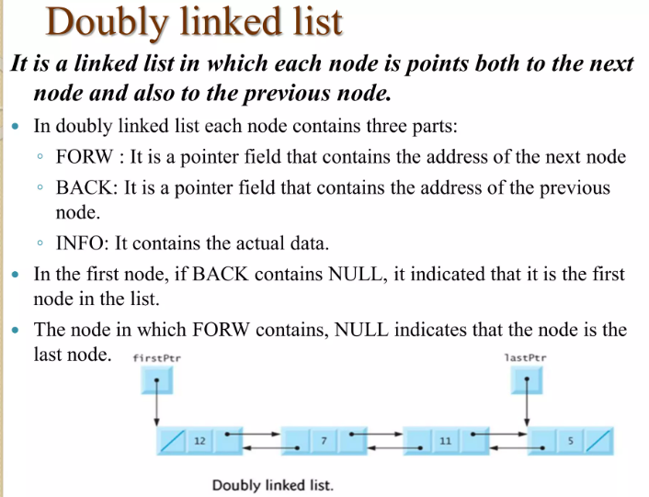

Slide 24
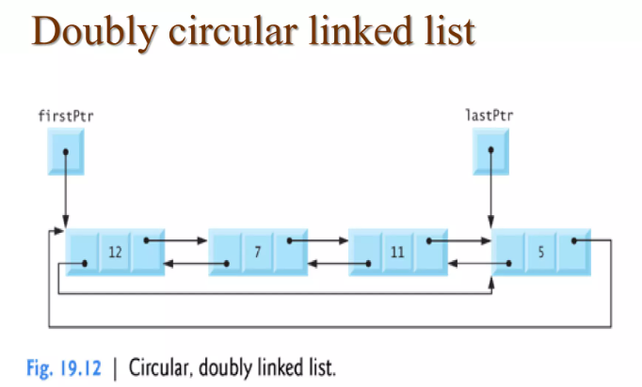

Slide 25
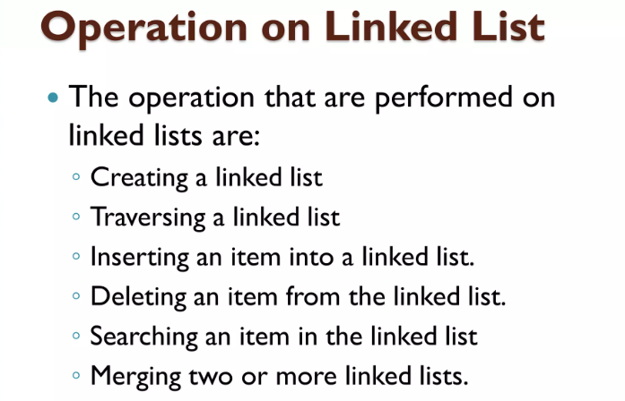

Slide 26
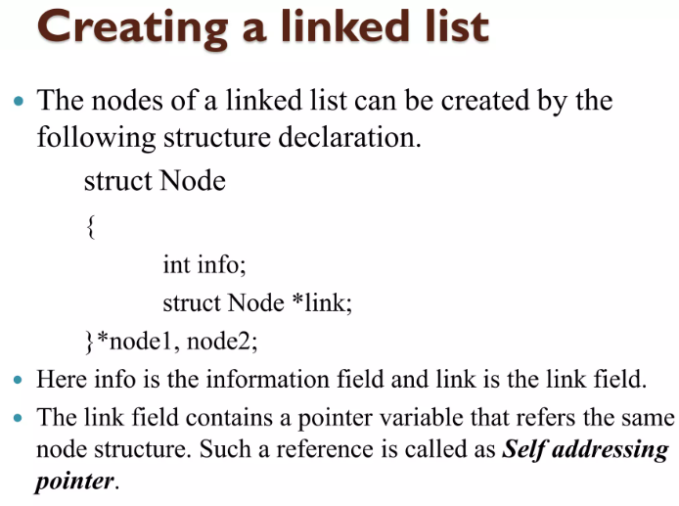

Slide 27
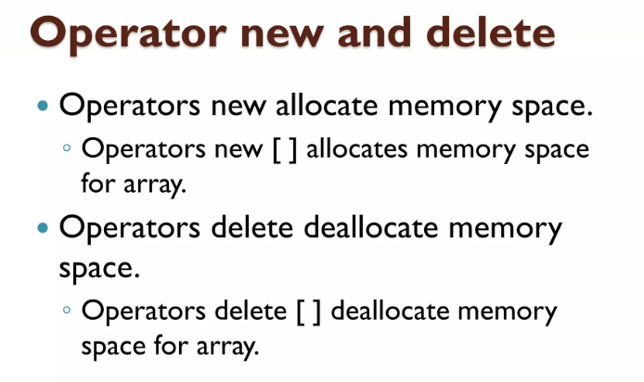

Slide 28
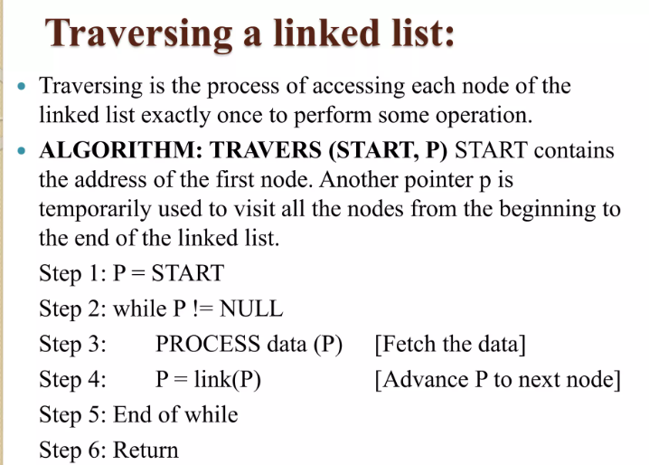

Slide 29
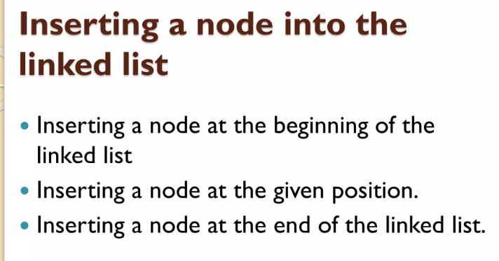

Slide 30
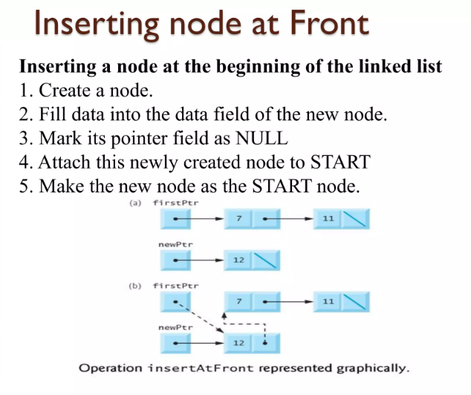

Slide 31
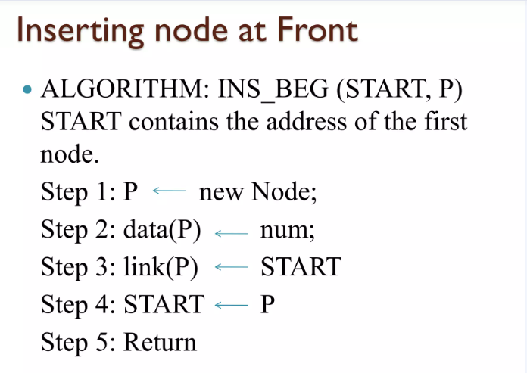

Slide 32
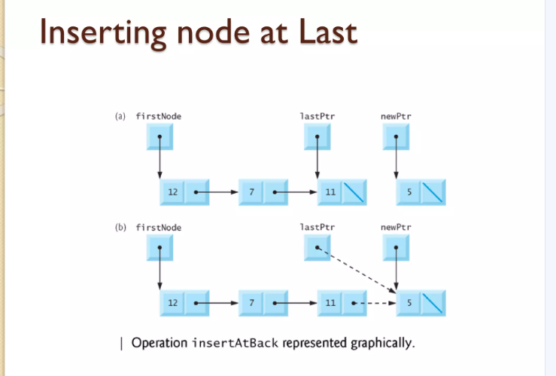

Slide 33
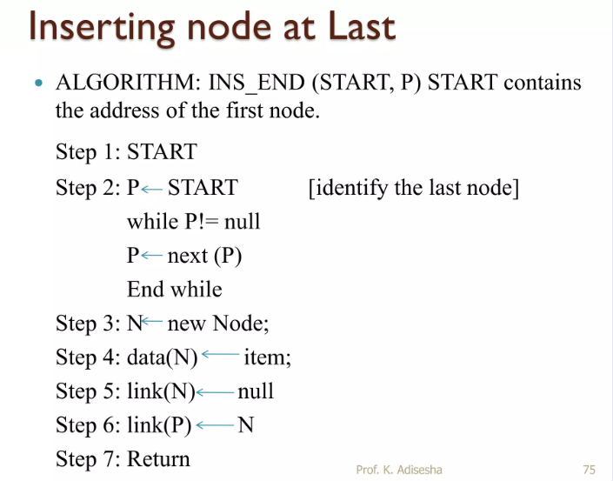

Slide 34
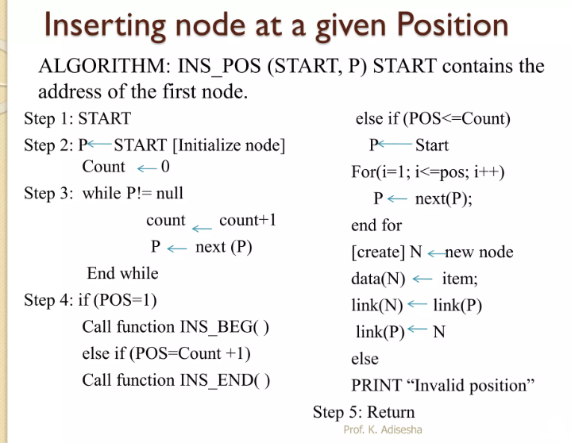

Slide 35
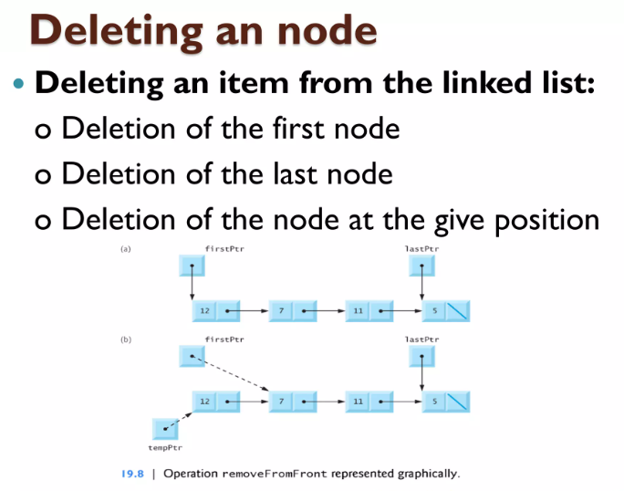

Slide 36
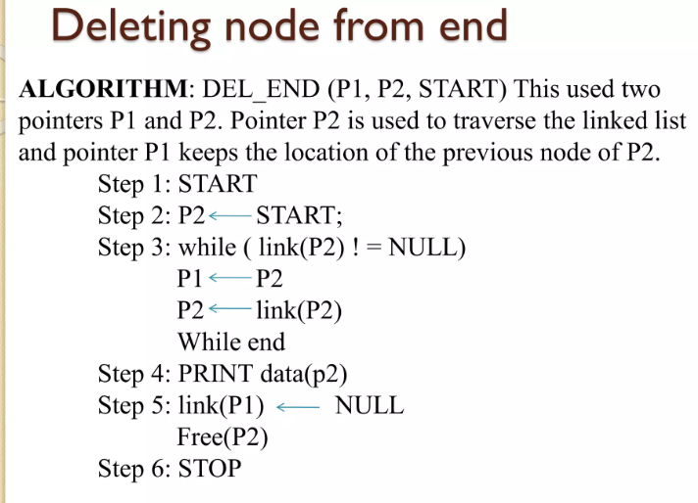

Slide 37
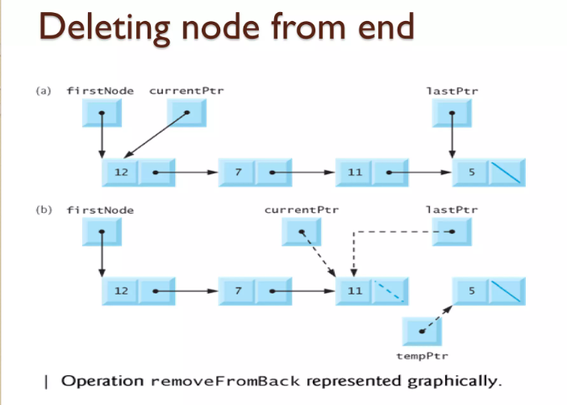

Slide 38
Operations on Linked Lists
Insertion: Adding a new node to a linked list involves adjusting the pointers of the existing nodes to maintain the proper sequence. Insertion can be performed at the beginning, end, or any position within the list
Deletion: Removing a node from a linked list requires adjusting the pointers of the neighboring nodes to bridge the gap left by the deleted node. Deletion can be performed at the beginning, end, or any position within the list.
Searching: Searching for a specific value in a linked list involves traversing the list from the head node until the value is found or the end of the list is reached.

Slide 39
#include<stdlib.h>
#include<stdio.h>
struct Node {
int data;
struct Node *next; };
void deleteStart (struct Node** head) {
struct Node* temp = *head;
// If head is NULL it means Singly Linked List is empty
if(*head == NULL){
printf("Impossible to delete from empty Singly Linked List");
return;
}
// move head to next node
*head = (*head)->next;
printf("Deleted: %d\n", temp->data);
free(temp);
}

Slide 40
void insertStart(struct Node** head, int data){ // dynamically create memory for this new Node
struct Node* newNode = (struct Node*) malloc(sizeof(struct Node)); // assign data value
newNode->data = data;
// change the next node of this new Node // to current head of Linked List
newNode->next = *head;
//re-assign head to this newNode
*head = newNode;
printf("Inserted %d\n",newNode->data); }
void display(struct Node* node){
printf("\nLinked List: "); // as linked list will end when Node is Null
while(node!=NULL){ printf("%d ",node->data);
node = node->next;
} printf("\n"); }
int main()
{ struct Node* head = NULL;
insertStart(&head,100); insertStart(&head,80); insertStart(&head,60); insertStart(&head,40);
insertStart(&head,20); display(head); deleteStart(&head); deleteStart(&head);
display(head); return 0; }

Slide 41
Output
Inserted 100
Inserted 80
Inserted 60
Inserted 40
Inserted 20
Linked List: 20 40 60 80 100
Deleted: 20
Deleted: 40
Linked List: 60 80 100

Slide 43
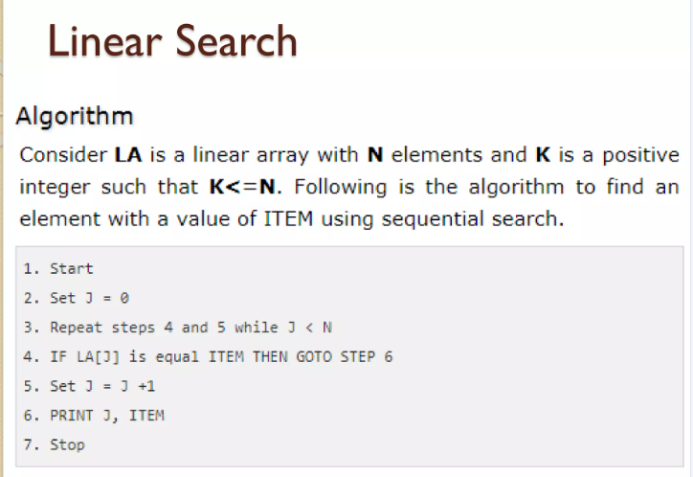

Slide 44
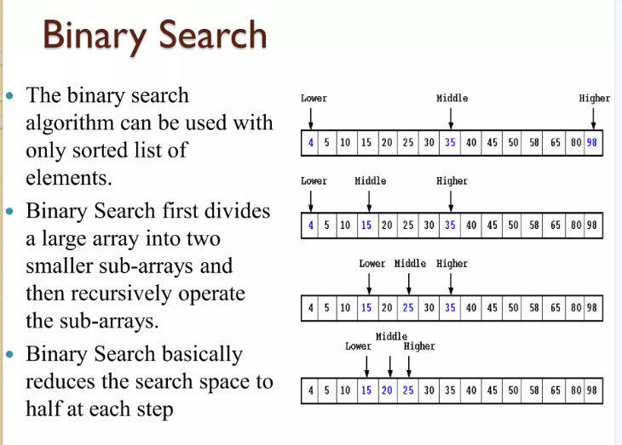

Slide 45
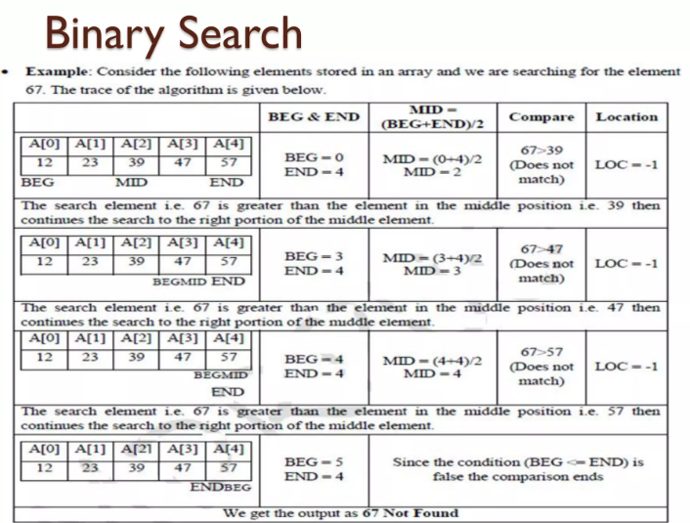

Slide 46
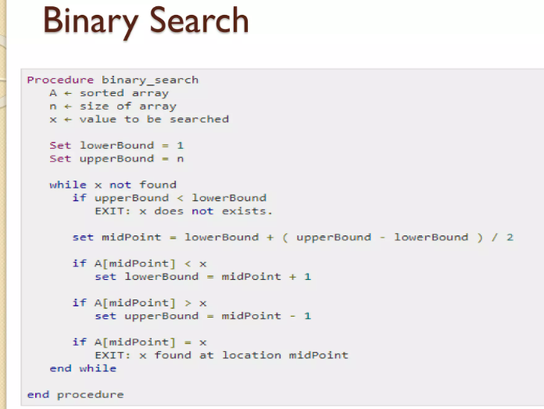

Slide 47
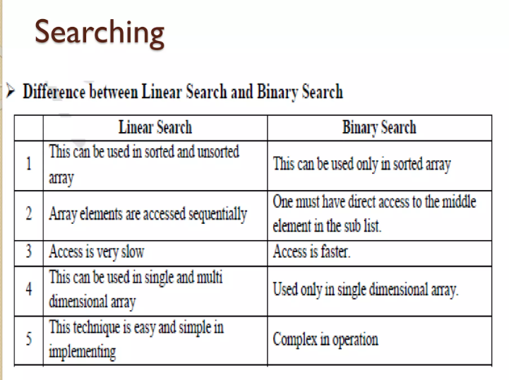

Slide 48
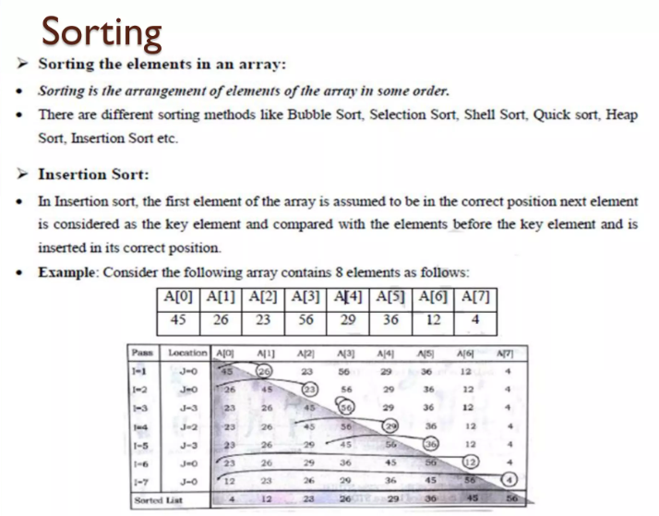

Slide 49
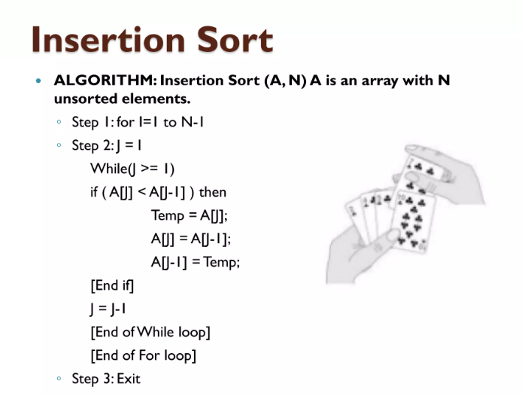

Slide 50
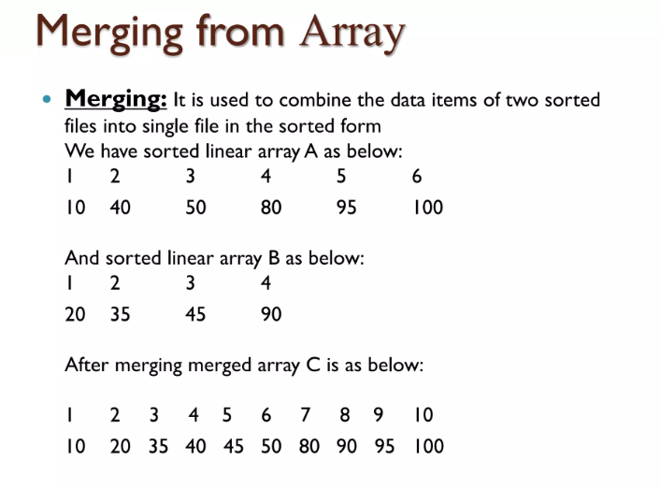

Slide 51
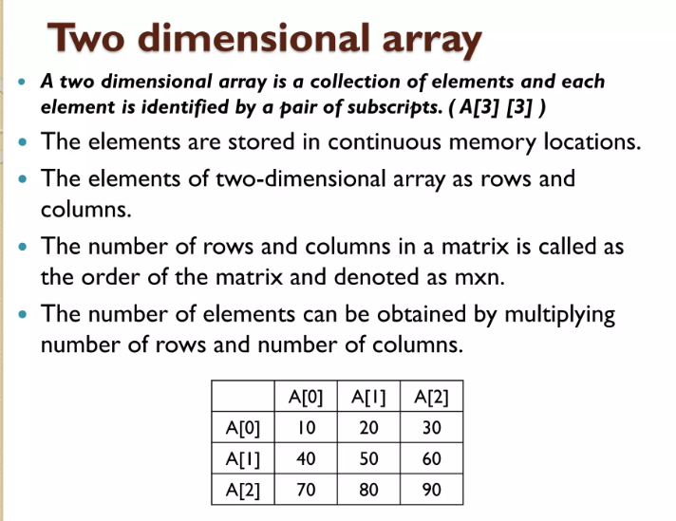

Slide 52
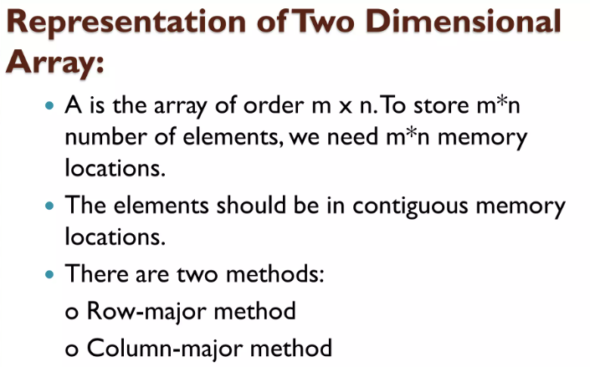

Slide 53


Slide 54


Slide 55


Slide 56


Slide 57


Slide 58


Slide 59


Slide 60


Slide 61


Slide 62


Slide 63


Slide 64


Slide 65


Slide 66


Slide 67


Slide 68


Slide 69


Slide 70


Slide 71


Slide 72


Slide 73


Slide 74


Slide 75


Slide 76


Slide 77


Slide 78


Slide 79


Slide 80


Slide 81


Slide 82


Slide 83


Slide 84


Slide 85


Slide 86


Slide 87


Slide 88


Slide 90

What is linear search in Python?
Linear search is the most basic type of search that is performed. It is also called the sequential search. In this search, we check each element in the given list one by one until a match is found.
This method is often used in our daily life like when we check grocery items, we do so in a linear search manner.
Technically in Python, This search method compares each and every element with the particular value that we are searching for. If both are matched, the element is found, and the algorithm returns the key’s index position.

Slide 91

Algorithm of linear search:
Before writing any code of the program, we must know its algorithm. So let’s understand the algorithm of this program.
Input a list of numbers.
Input the item to be searched.
Compare that element with each and every element of the list one by one.
If the match is found, then return True.
If the match is not found in the whole list, then return False.

Slide 92
#Method 1: Linear search Using range()
list1 = [16, 2, 7, 5, 12, 54, 21, 9, 64, 12]
print('List has the items: ', list1)
Item = int(input('Enter a number to search for: '))
found = False
for i in range(len(list1)):
if list1[i] == Item:
found = True
print(Item, ' was found in the list at index ', i)
break
if found == False:
print(Item, ' was not found in the list!')
#Output
List has the items: [16, 2, 7, 5, 12, 54, 21, 9, 64, 12]
Enter a number to search for: 7
7 was found in the list at index 2

Slide 93
#Method 2: Linear search using def().
def linear(x,y): for i in x:
if i ==y:
return true return false
x = [12, 37, 45, 89, 1, 2, 34, 48, 9]
linear(x,2)
linear(x,9) linear(x,5)
#Output
True
True
False

Slide 94

Binary Search
Binary search in python uses a divide-and-conquer strategy to significantly speed up searching in sorted data as opposed to linear search, which examines each element one at a time.
Binary search in C only works on sorted data sets. The collection must be arranged in ascending or descending order. This sorting enables the divide-and-conquer approach.
The key steps are:
Find midpoint index of the entire dataset.
Compare element at midpoint against target value.
If equal, return index of match.
If less, repeat search on left half.
If greater, repeat search on right half.
This recursive halving of search space enables tremendous efficiency gains.

Slide 95
We have a sorted array arr[] = {2, 5, 8, 12, 16, 23, 38, 56, 72, 91} and we want to search for the value 23.
The steps are:
Set lower index to 0 and the upper index to n-1.
Here, n is the number of elements in the array, which is 10. So lower = 0 and upper = 9 (10-1 = 9)
Calculate the mid index as mid = (lower + upper) / 2. In this case, mid = (0 + 9) / 2 = 4.
Compare the value at arr[mid] with the target value 23. Here arr[mid] is arr[4], which is 16.
Since 16 is less than 23, the target is greater than the mid element. So set lower = mid +
This eliminates the left half of the array.
Recalculate mid index with new lower and upper bounds. mid = (lower + upper) / 2 = (5+ 9) / 2 = 7
Check if arr[mid] (which is 38) equals target. It does not. Since 38 > 23, set upper = mid - 1
This eliminates the right half.
Recalculate mid as (lower + upper) / 2 = (5 + 6) / 2 = 5
Check arr[mid] (which is 23) against the target 23. It matches!
Return the index mid.

Slide 96
Concept of Binary Search
In the binary search algorithm, we can find the element position using the following methods:
Recursive Method
Iterative Method
The divide-and-conquer approach technique is followed by the recursive method. In this method, a function is called again and again until it finds an element in the list.
We have a sorted list of elements, and we are looking for the index position of 45. [12, 24, 32, 39, 45, 50, 54]
So, we are setting two pointers in our list. One pointer is used to denote the smaller value called low, and the second pointer is used to denote the highest value called high.
Next, we calculate the value of the middle element in the array.
Now, we will compare the searched element to the mid-index value. In this case, 32 is not equal to 45. So we need to do further comparisons to find the element.
If the number we are searching for is equal to the mid, then return the mid; otherwise, move to the next comparison.
The number to be searched is greater than the middle number, so we compare the n with the middle element of the elements on the right side of mid and set low to low = mid + 1.
Otherwise, compare the n with the middle element of the elements on the left side of mid, and set high to high = mid—1.

Slide 97


Slide 98
# Iterative Binary Search Function method Python Implementation
# It returns index of n in given list1 if present, # else returns -1
def binary_search (list1, n): low = 0
high = len(list1) - 1 mid = 0
while low <= high:
# for get integer result mid = (high + low) // 2
# Check if n is present at mid if list1[mid] < n:
low = mid + 1
# If n is greater, compare to the right of mid elif list1[mid] > n:
high = mid – 1
# If n is smaller, compared to the left of mid else:
return mid
# element was not present in the list, return -1 return -1
# Initial list1
list1 = [12, 24, 32, 39, 45, 50, 54]
n = 45

Slide 99
# Iterative Binary Search Function method Python Implementation
# It returns index of n in given list1 if present, # else returns -1
# function call result = binary_search(list1, n)
if result != -1:
print("Element is present at index", str(result))
else:
print("Element is not present in list1")
OUT PUT
Element is present at index 4

Slide 100
Explanation:
In the above program - We have created a function called binary_search() function which takes two arguments
— a list to sorted and a number to be searched.
We have declared two variables to store the lowest and highest values in the list.
The low is assigned initial value to 0, high to len (list1) — 1 and mid as 0.
Next, we have declared the while loop with the condition that the lowest is equal and smaller than the highest
The while loop will iterate if the number has not been found yet.
In the while loop, we find the mid value and compare the index value to the number we are searching for.
If the value of the mid-index is smaller than n, we increase the mid value by 1 and assign it to The search moves to the left side.
Otherwise, decrease the mid value and assign it to the high. The search moves to the right side. If the n is equal to the mid value then return mid.
This will happen until the low is equal and smaller than the high.
If we reach at the end of the function, then the element is not present in the list. We return -1 to the calling function.

Slide 101
Recursive Binary Search:
The recursion method can be used in the binary search. In this, we will define recursive function that keeps calling itself until it meets the condition.
Python Program
Python program for recursive binary search
# Returns index position of n in list1 if present, otherwise -1 def binary_search (list1, low, high, n):
# Check base case for the recursive function if low <= high:
mid = (low + high) // 2
# If element is available at the middle itself then return the its index if list1[mid] == n:
return mid

Slide 102
# If the element is smaller than mid value, then search moves
# left sublist1
elif list1[mid] > n:
return binary_search(list1, low, mid - 1, n)
# Else the search moves to the right sublist1 else:
return binary_search(list1, mid + 1, high, n) else:
# Element is not available in the list1 return -1
# Test list1ay
list1 = [12, 24, 32, 39, 45, 50, 54]
n = 32
# Function call
res = binary_search(list1, 0, len(list1)-1, n) if res != -1:
print("Element is present at index", str(res))
else:
print("Element is not present in list1")
Output:
Element is present at index 2

Slide 103
Explanation
The above program is similar to the previous program. We declared a recursive function and its base condition. The condition is the lowest value is smaller or equal to the highest value.
We calculate the middle number as in the last program.
We have used the if statement to proceed with the binary search.
If the middle value equal to the number that we are looking for, the middle value is returned.
If the middle value is less than the value, we are looking then our recursive function
binary_search() again and increase the mid value by one and assign to low.
If the middle value is greater than the value we are looking then our recursive function
binary_search() again and decrease the mid value by one and assign it to low.
In the last part, we wrote our main program. It is the same as the previous program, but the only difference is that we have passed two parameters in the binary_search() function.
This is because we can’t assign the initial values to the low, high and mid in the recursive function. Every time the recursive is called the value will be reset for those variables. That will give the wrong result.

Slide 104


Slide 105
Python implementation
import math
def binarySearch(lst, key):
low = 0
end = len(lst) -1
while low <= end:
mid = math.floor((low + end)/2)
if key == lst[mid]:
return f 'key {key} = lst[{mid}]'
elif
key < lst[mid]: end = mid - 1
else:
low = mid + 1
return f'{key} is not in this list'

